Slide 1
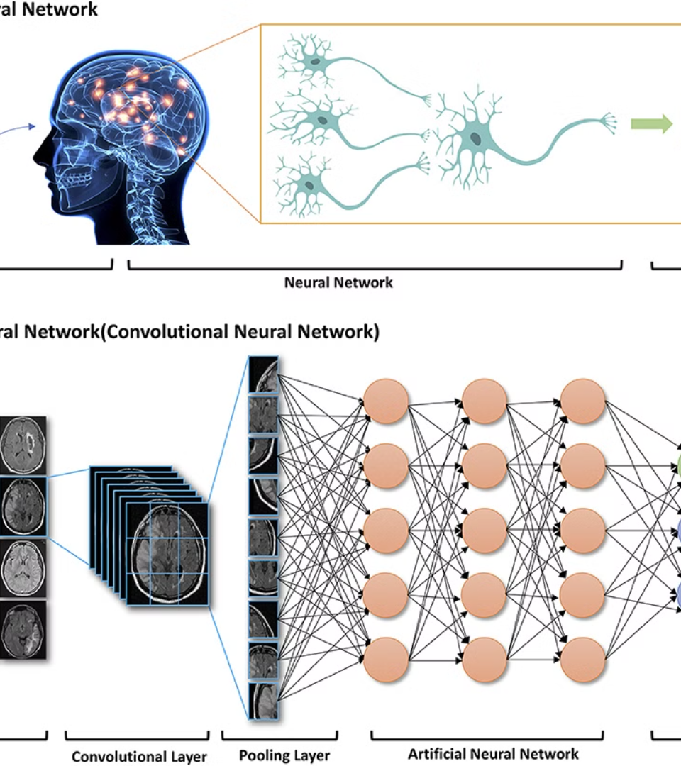

Introduction to Deep Learning
Deep learning is a subset of machine learning that uses neural networks with multiple layers to extract higher-level features from data. It's at the forefront of artificial intelligence, enabling machines to automatically learn and make decisions from data.

Slide 2
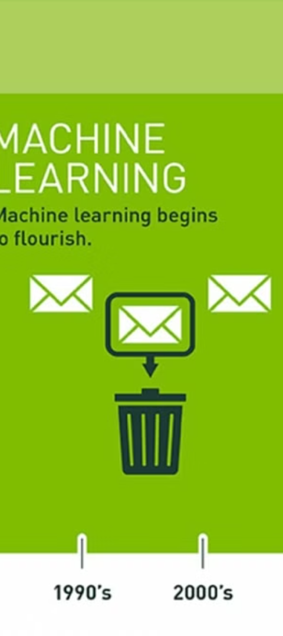
What is Deep Learning?
1
Complex Data Analysis
2
Feature Extraction
Deep learning is capable of analyzing and processing complex, unstructured data such as images, audio, and natural language.
It focuses on automatically identifying and extracting hierarchical representations of data, leading to more accurate results.
3
Pattern Recognition
It is used to recognize patterns and make decisions based on those patterns, typically mimicking the human brain's capabilities.

Slide 3
Neural Networks and Their Architecture
Structure
Activation Functions
Training Algorithms
Neural networks consist of layers of interconnected nodes that process and transform data, eventually producing an output.
Each node applies a mathematical function to the input signal, transforming it into the desired output.
Different optimization algorithms are used to adjust the connections' strengths based on the input data.

Slide 4
neural networks vs deep neural networks
neural networks have three layers : input layer, hidden layer, output layer
Deep neural networks : is a type of neural network with multiple hiden layers between the input and the output layers. The term “deep” refers to the number of hidden layers
The key difference between a Neural Network and a Deep Neural Network is the depth of the network.

Slide 5



Training Deep Learning Models
Data Collection
Acquire and preprocess the data used to train the model.
Model Building
Develop the architecture and parameters of the deep learning model for the specific task.
Evaluation
Assess the model's performance on validation data and fine-tune it for better accuracy.

Slide 6
Deep learning architectures
Artificial neural networks
Recurrent neural networks
Long Short term memory (LSTM )
Convolutional neural networks (CNN)
Transformer
Generative adversial Networks (GAN)

Slide 7
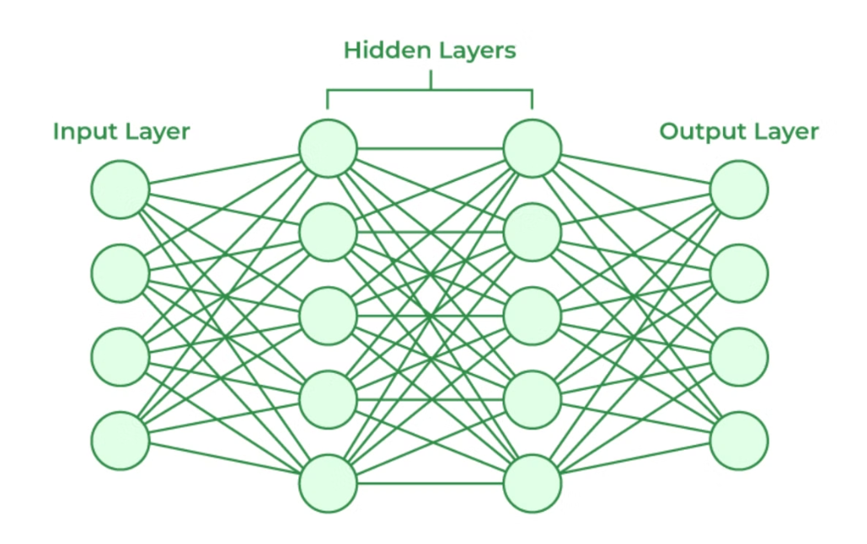
Artificial neural networks

Slide 8

Recurrent neural networks

Slide 9
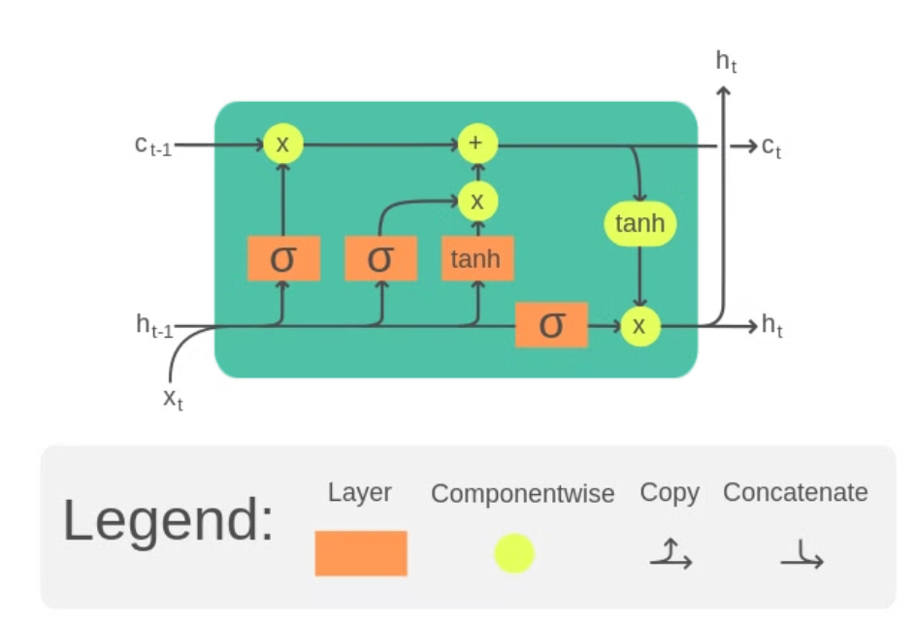
Long Short Term Memory

Slide 10

Transformer

Slide 11
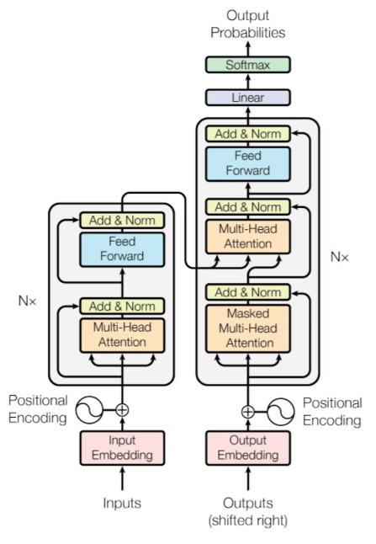

Slide 12
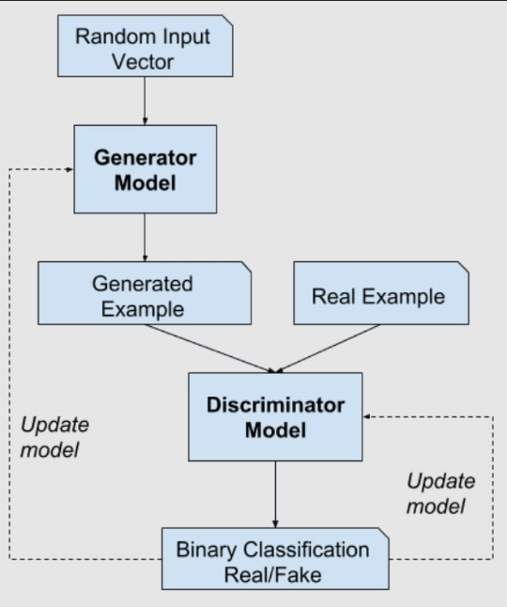
Generative adversarial network

Slide 13
What is a CNN?
The name «Convolutional Neural Network» indicates that the network employs a mathematical operation called Convolution. Convolution is a specialized kind of linear operation. Convolutional networks are simply neural networks that use convolution in place of general matrix multiplication in at least one of their layers.

Slide 14
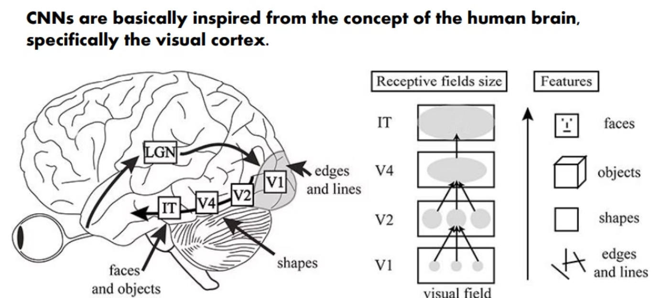
Architecture of the visual cortex:

Slide 15
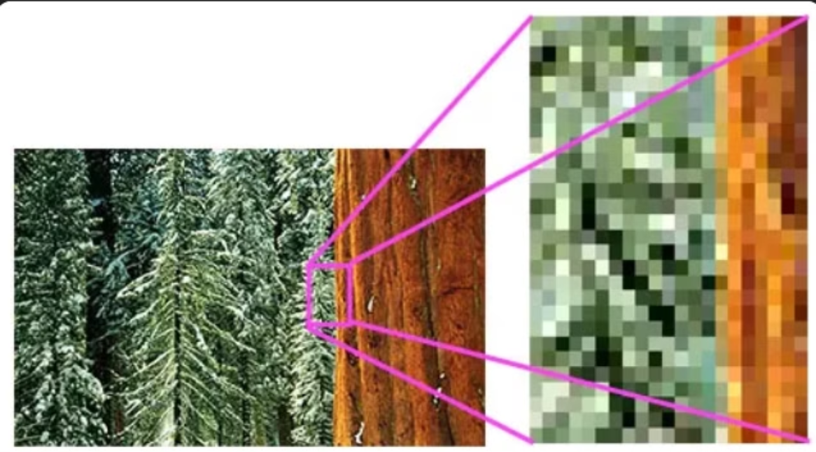
images
pixel

Slide 16

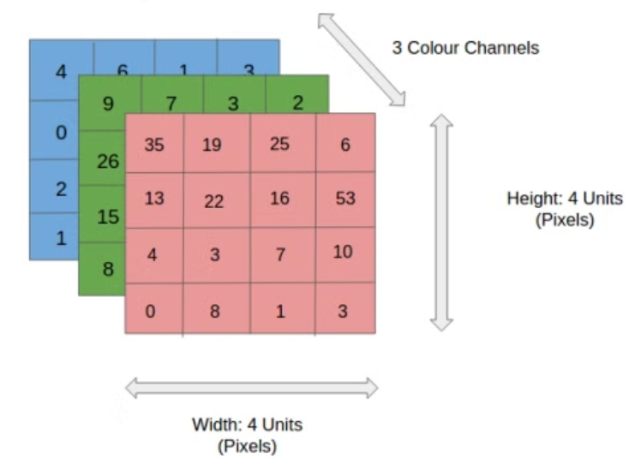
images
RGB

Slide 17
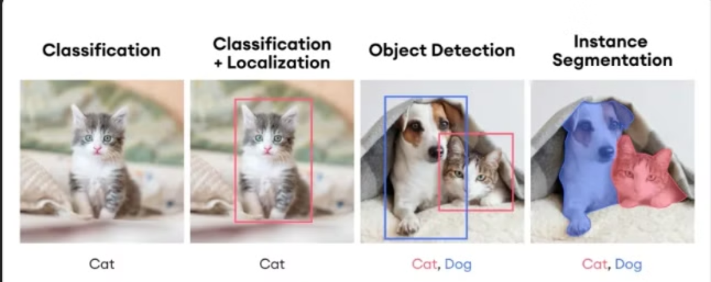
classification vs object detection vs segmentation

Slide 18

PyTorch Library
1
Dynamic Computation Graphs
2
Scalability
3
Research and Production
It supports easy scaling of deep learning models to large datasets and GPUs.
PyTorch allows for the creation of computational graphs that change during runtime, providing flexibility.
Used extensively in both academic research and production environments for various applications.

Slide 19

TensorFlow Library
Highly Scalable
Provides distributed computing and deployment across multiple platforms.
Rich Ecosystem
Comes with a wide variety of tools, libraries, and community support for deep learning tasks.
Model Compatibility
Supports easy integration with different hardware, allowing for efficient model deployment.

Slide 20
what are tensors
central data abstraction used for numeric computation. you can create array of tensors,integers, float . can run on either CPU or GPU.

